Slide 1
Remedial Measures Wrap-Up and Transformations – Box Cox
Dr. Frank Wood
TexPoint fonts used in EMF.
Read the TexPoint manual before you delete this box.: AAAAAAAAA

Slide 2
Last Class
Graphical procedures for determining appropriateness of regression fit
  Normal probability plot
Tests to determine
  Constancy of error variance
  Appropriateness of linear fit
What do we if we determine (through testing or otherwise) that the linear regression fit is not good?

Slide 3
Overview of Remedial Measures
If simple regression model is not appropriate there are two choices
  Abandon simple regression model and develop and use a more appropriate model
  Employ some transformation of the data so that the simple regression model is appropriate for the transformed data.

Slide 4
Fixes For…
Nonlinearity of regression function
  Transformation(s) (today)
Nonconstancy of error variance
  Weighted least squares (nice project idea, coming later in class) and transformations
Nonindependence of error terms
  Directly model correlation or use first differences (may skip)
Nonnormality of error terms
  Transformation(s) (today)
Omission of important predictor variables
  Multiple regression – coming soon
Outlying observations
  Robust regression (another nice project idea)

Slide 5
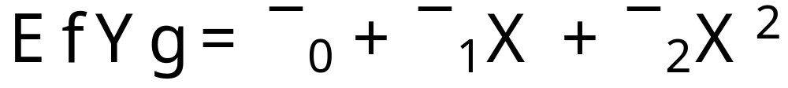
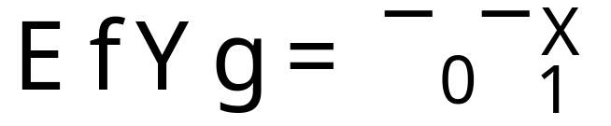
Nonlinearity of regression function
Direct approach
    Modify regression model by altering the nature of the regression function. For instance a quadratic regression function might be used
    or an exponential function
    Such approaches employ a transformation to (approximately) linearize a regression function

Slide 6
Quick Questions
How would you fit such models?
How does the exponential regression function relate to regular linear regression?
Where did the error terms go?

Slide 7
Transformations
Transformations for Nonlinear Relation Only
  Appropriate when the distribution of the error terms is reasonably close to a normal distribution
  In this situation
    transformation of X should be attempted
    transformation of Y should not be attempted because it will materially effect the distribution of the error terms

Slide 8
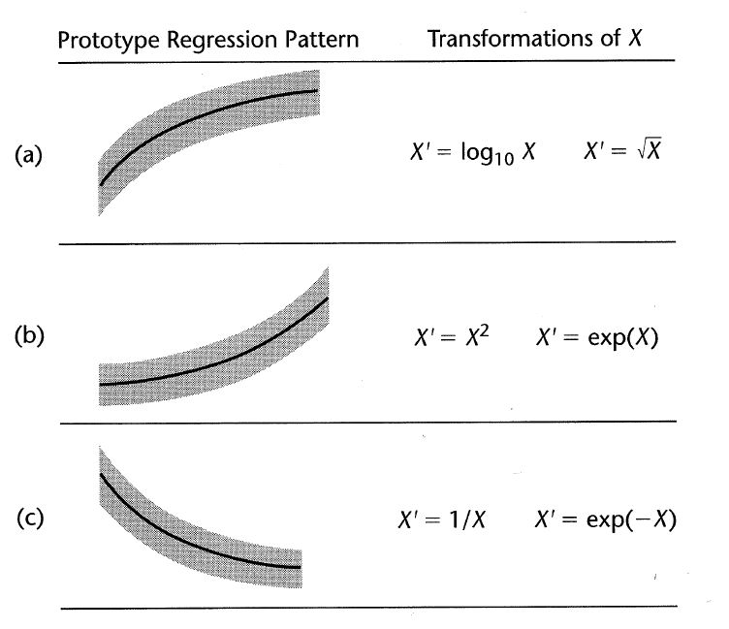
Prototype Regression Patterns
Note constancy
error terms

Slide 9
Example
Experiment
  X : days of training received
  Y : sales performance (score)

Slide 10
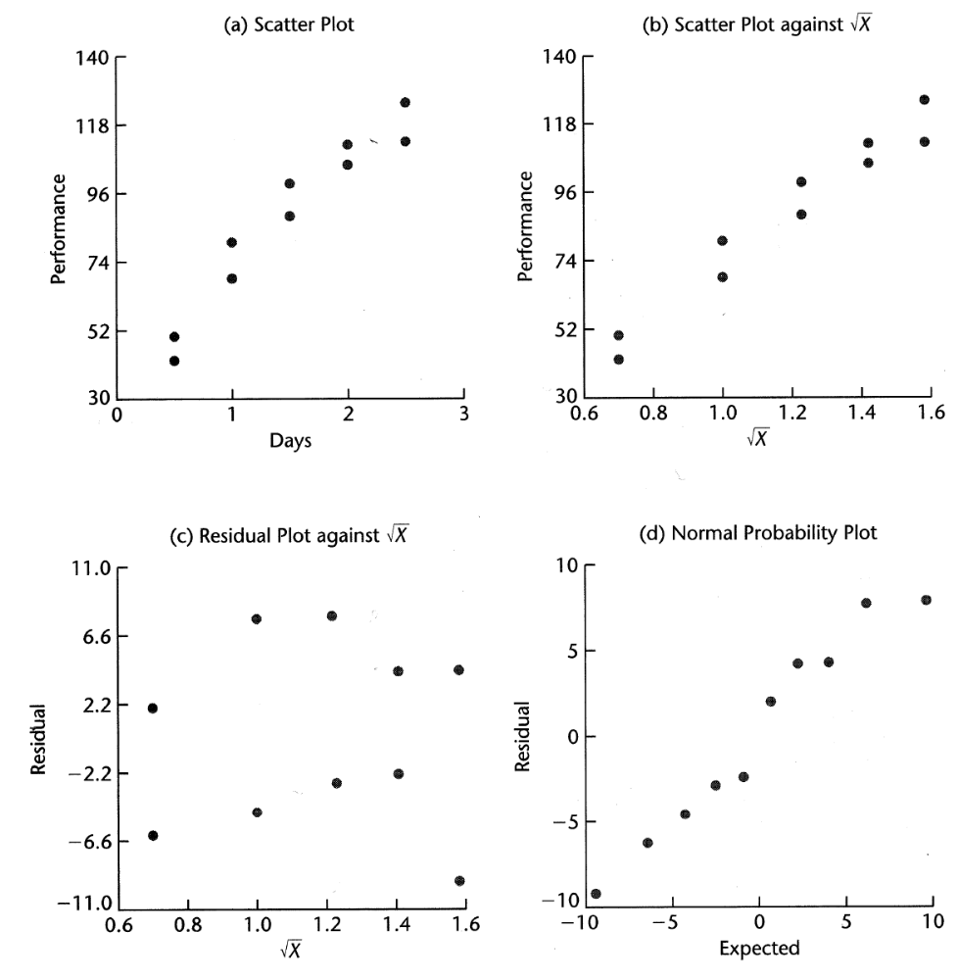
X’ = sqrt(X)

Slide 11
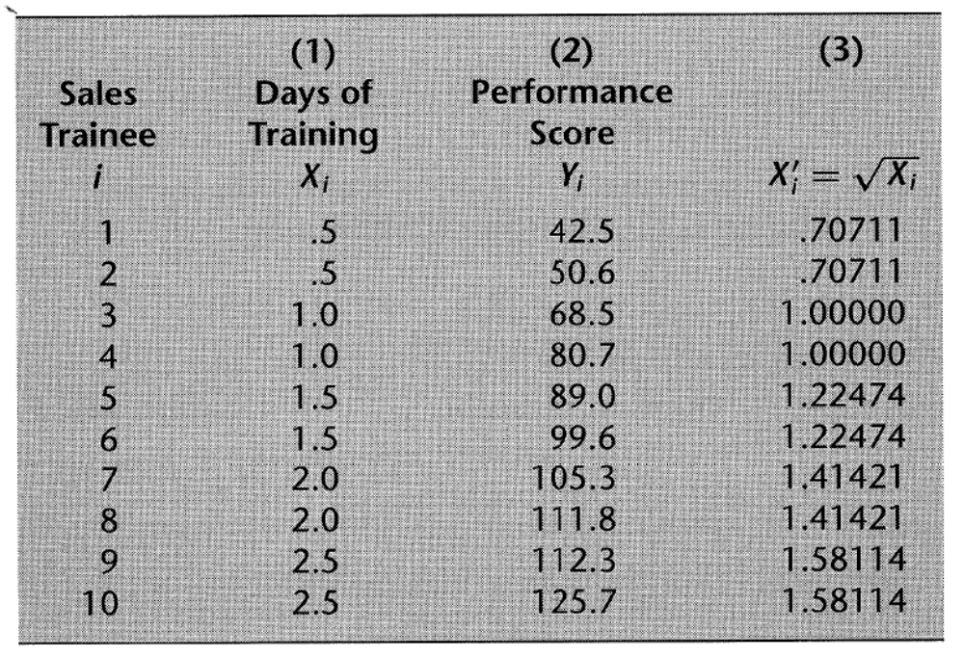
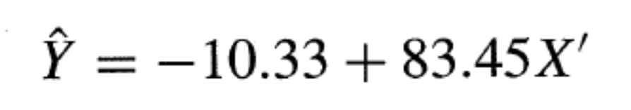
Example Data Transformation

Slide 12
Graphical Residual Analysis

Slide 13
Matlab
Run matlab_demos\transform_X.m

Slide 14
Transformations on Y
Nonnormality and unequal variances of error terms frequently appear together
To remedy these in the normal regression model we need a transformation on Y
This is because
  Shapes and spreads of distributions of Y need to be changed
  May help linearize a curvilinear regression relation
Can be combined with transformation on X

Slide 15
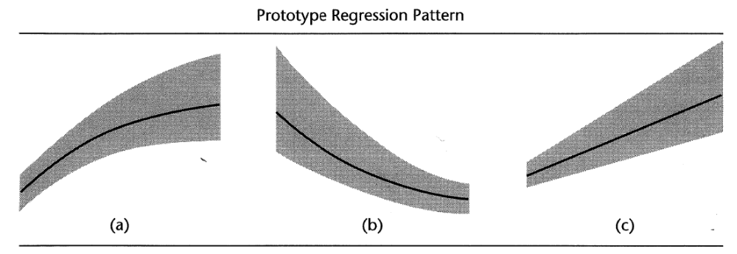
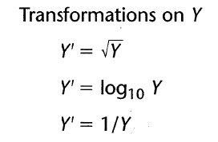
Prototype Regression Patterns and Y Transformations
Note change in
error distribution
as function of input

Slide 16
Example
Use of logarithmic transformation of Y to linearize regression relations and stabilize error variance
Data on age (X) and plasma level of a polyamine (Y) for a portion of the 25 healthy children in a study. Younger children exhibit greater variability than older children.

Slide 17
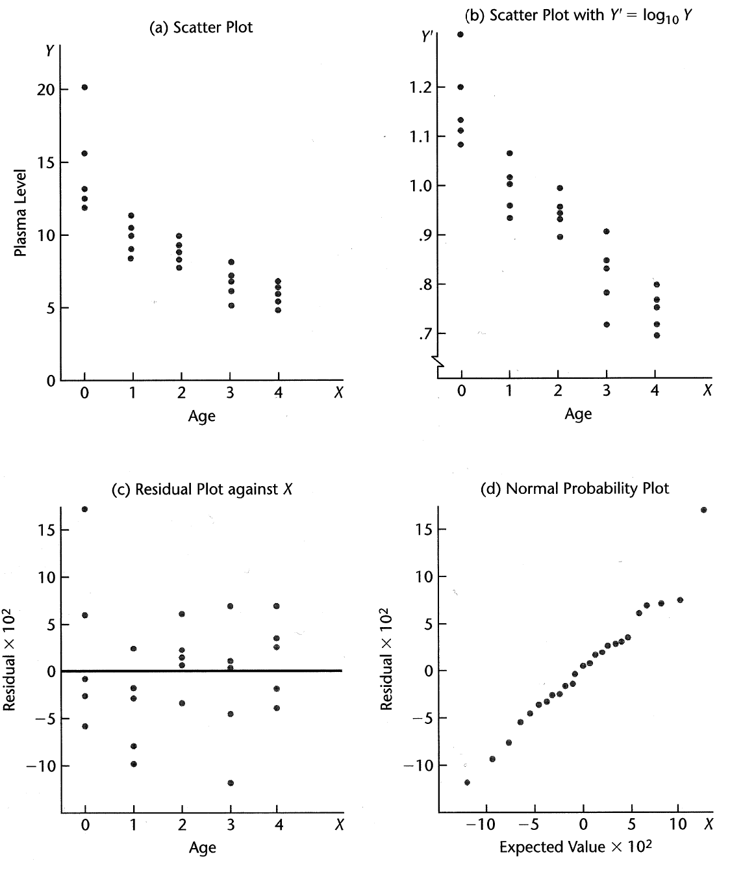
Plasma level versus age

Slide 18
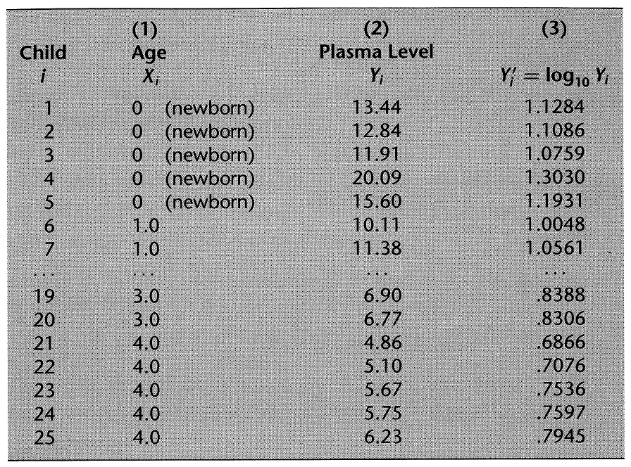
Associated Data

Slide 19
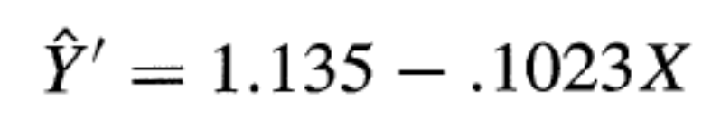
If we fit a simple linear regression line to the log transformed Y data we obtain
And the coefficient of correlation between the ordered residuals and their expected values under normality is .981 (for ® = .05 B.6 in the book shows a critical value of .959)
Normality of error terms supported, regression model for transformed Y data appropriate

Slide 20
Box Cox Transforms
It can be difficult to graphically determine which transformation of Y is most appropriate for correcting
  skewness of the distributions of error terms
  unequal variances
  nonlinearity of the regression function
The Box-Cox procedure automatically identifies a transformation from the family of power transformations on Y

Slide 21
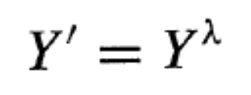
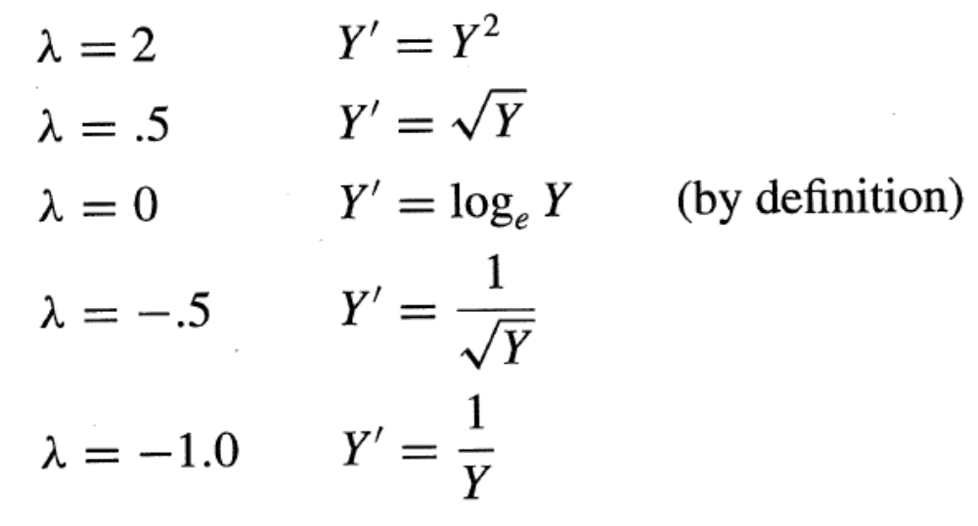
Box Cox Transforms
This family is of the form
Examples include

Slide 22
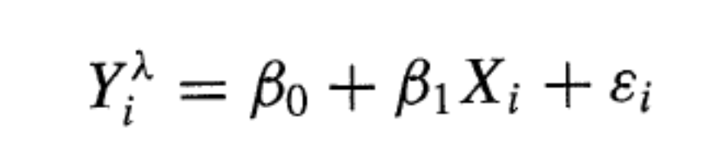
Box Cox Cont.
The normal error regression model with the response variable a member of the family of power transformations becomes
This model has an additional parameter that needs to be estimated
Maximum likelihood is a way to estimate this parameter

Slide 23
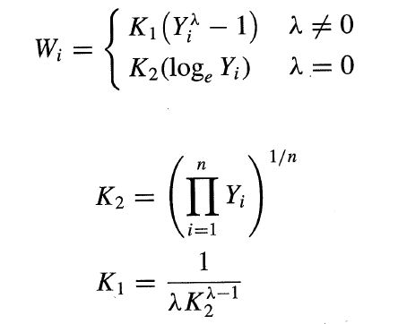
Box Cox Maximum Likelihood Estimation
Before setting up maximum likelihood estimation, the observations are further standardized so that the magnitude of the error sum of squares does not depend on the value of ¸
The transformation is given by
  where
geometric mean

Slide 24
Box Cox Maximum Likelihood Estimation
Maximize
w.r.t. ¸, ¾, b₁, and b₀
How?
  Take partial derivatives
  Solve
  or... gradient ascent methods
Show box_cox_demo.m

Slide 25
Comments on Box Cox
The Box-Cox procedure is ordinarily used only to provide a guide for selecting a transformation
At times, theoretical or other a priori considerations can be utilized to help in choosing an appropriate transformation
It is important to perform residual analysis after the transformation to ensure that the transformation is appropriate
When transformed models are employed, b₀ and b₁ obtained via least squares have the least squares property w.r.t. the transformed observations not the original ones.

